Slide 1
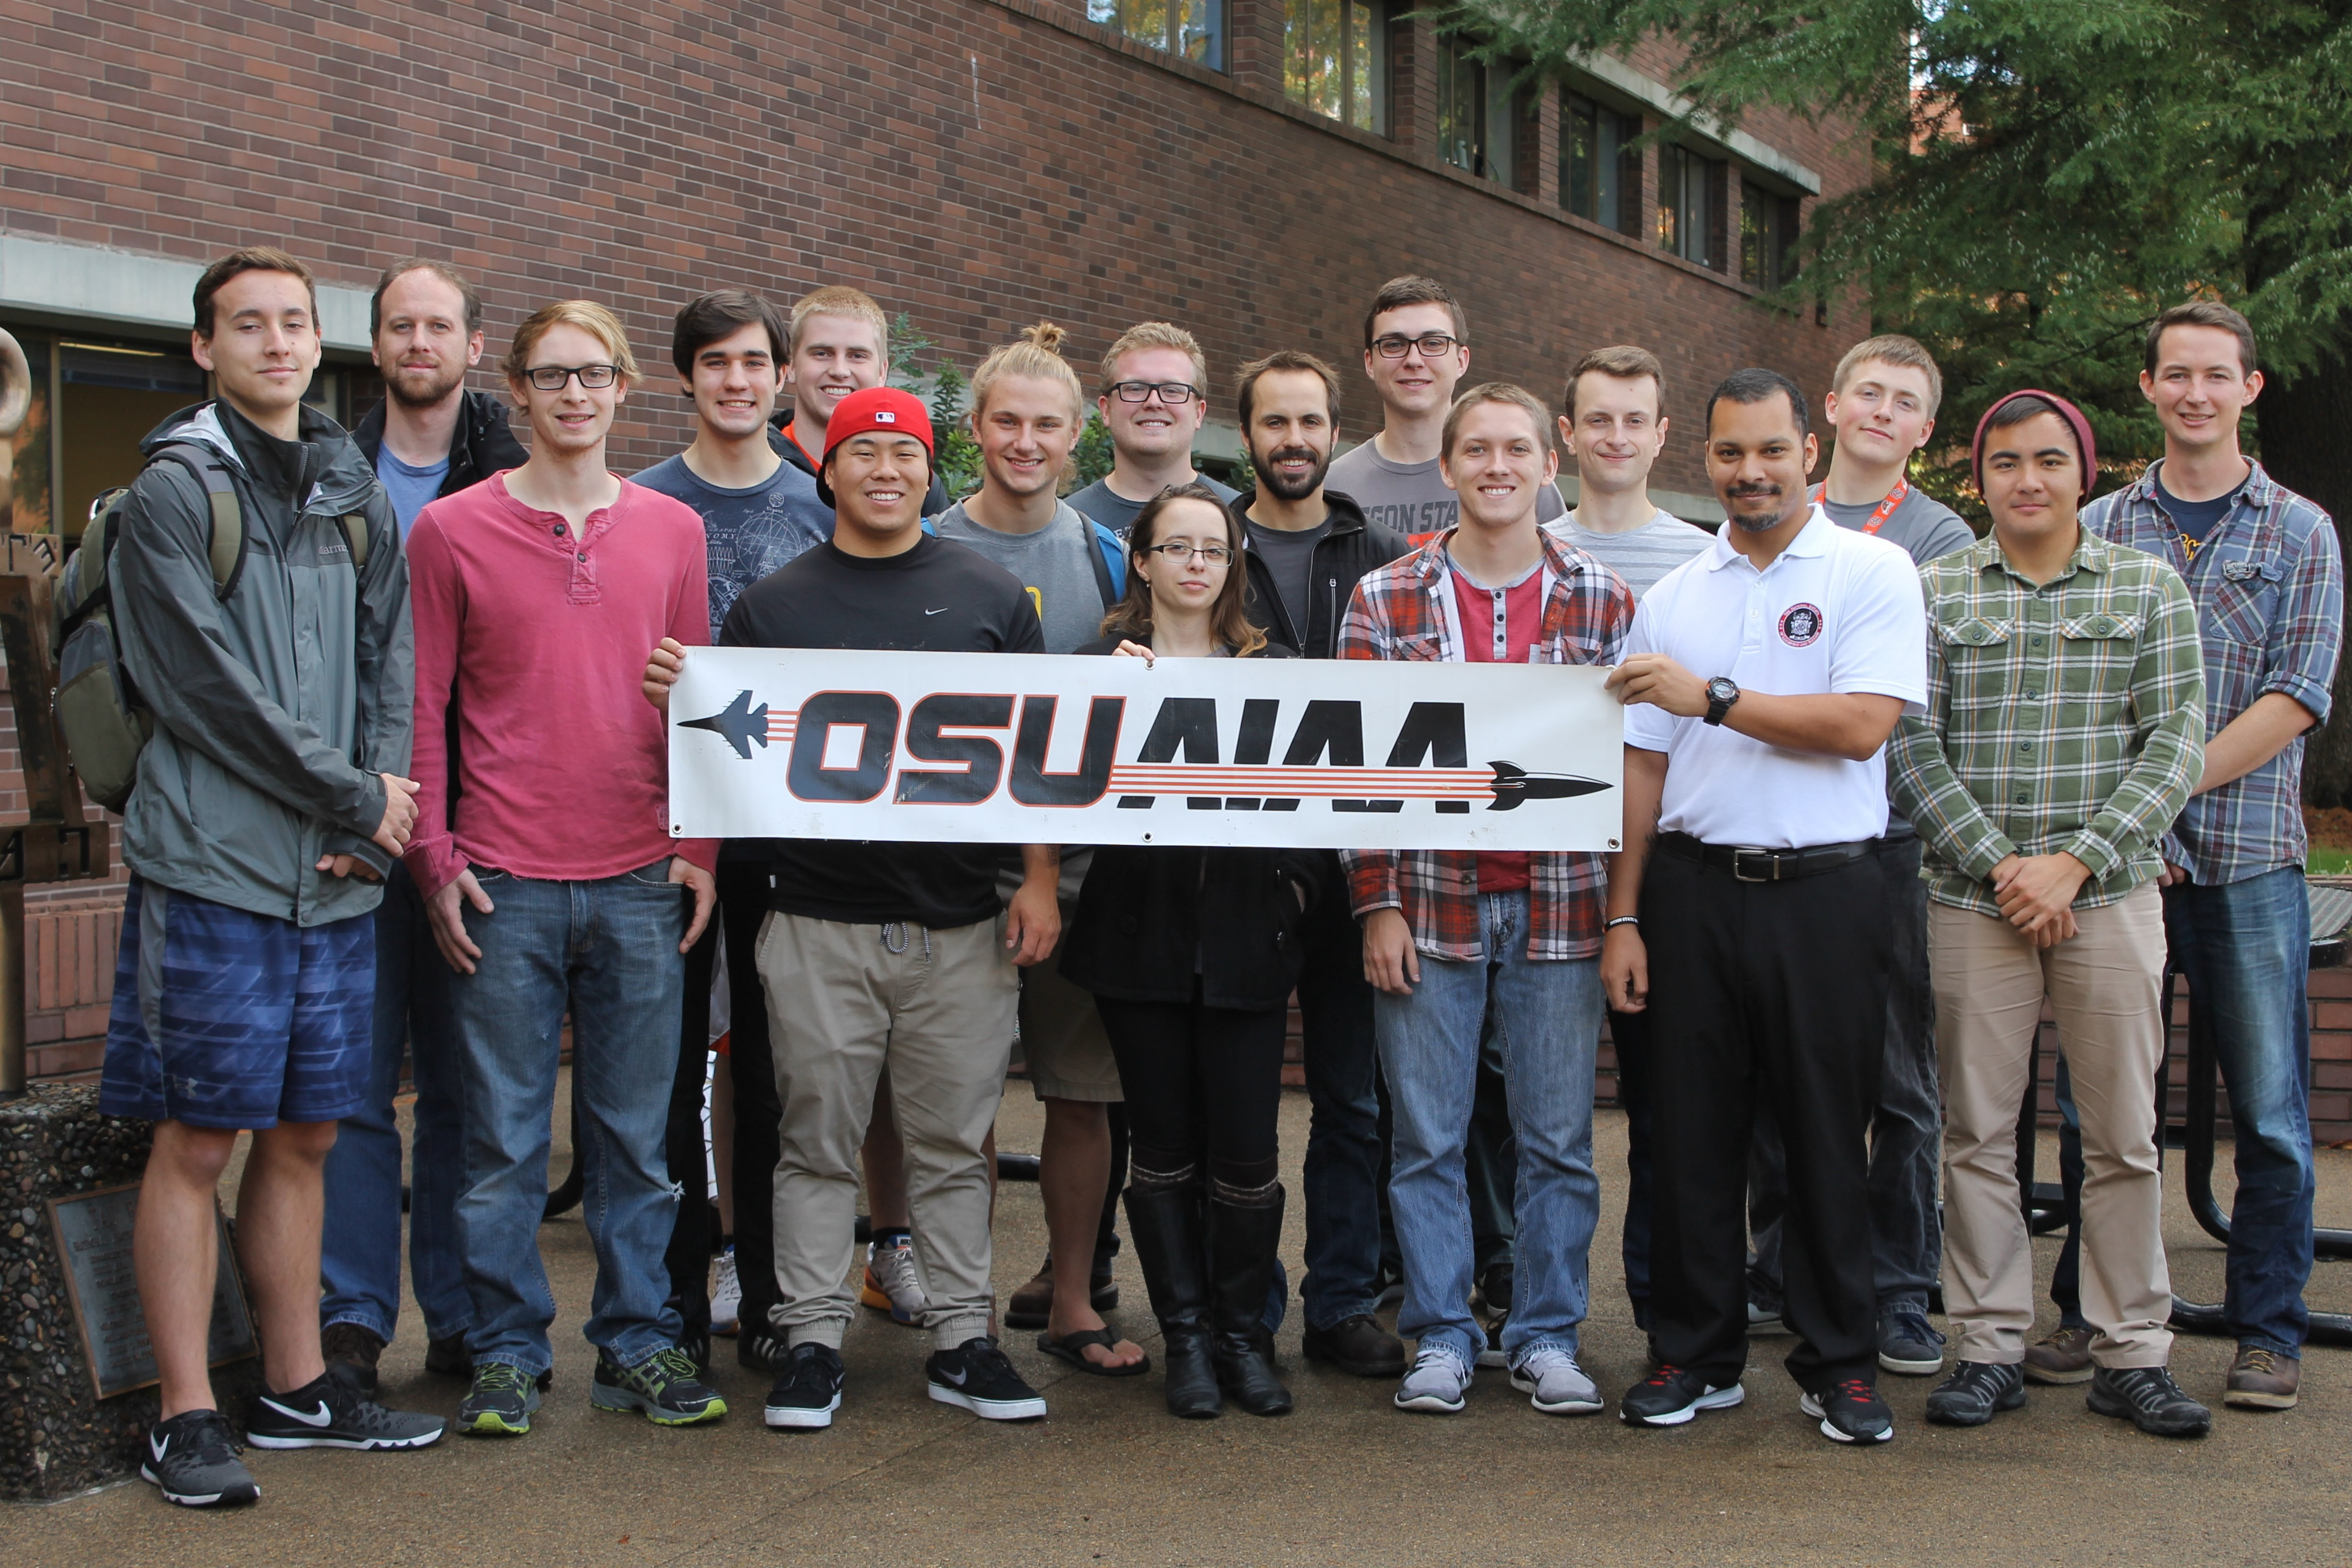
Fall Progress Report
Team #25
Natasha Anisimova, Terrance Lee, Albert Morgan

Slide 2

Introduction: The Problem
Launch a rocket in the Black Rock Desert
Receive telemetry and visualize in real-time
Aid in recovery
Track rocket
Log telemetry for later retrieval
Create a usable user interface

Slide 3
Our Clients
High-Altitude Rocketry Team
Led by Dr. Nancy Squires
Clients are engineering students
Software team given a lot of flexibility

Slide 4
Telemetry
Receive telemetry from the rocket over packet radio
Translate to serial protocol by avionics team
Read by Raspberry Pi through serial port
COCOM limits will cause us to lose GPS data
Create location prediction system

Slide 5
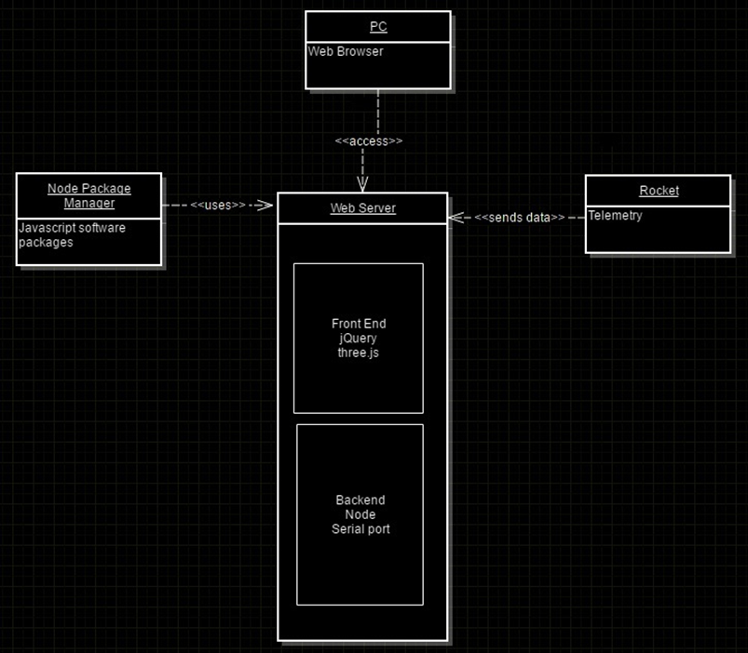
Backend
Raspberry Pi
Backend written in Node
One language (JavaScript) for whole system
Reuse libraries
One package manager (NPM)
Event driven architecture
Fast
Telemetry converted to JSON and transferred to client

Slide 6
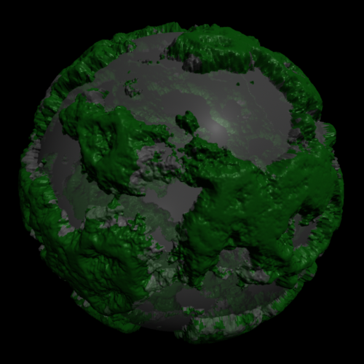
Frontend and Web Browser
Tables updating in Real-Time
3.js
WebGL canvas
Displacement mapping
GPS only turns on at Apigee

Slide 7
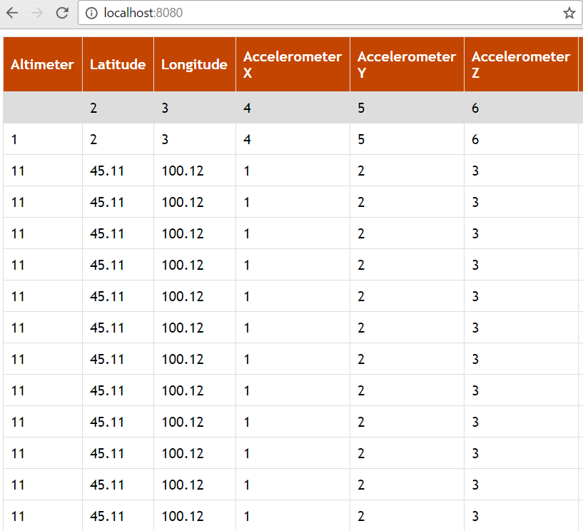
User Interface
Numerical Data
Data Visualization
Height Map for Spaceport America
Mike Bailey
Scale aspect ratio
Web dependencies

Slide 8
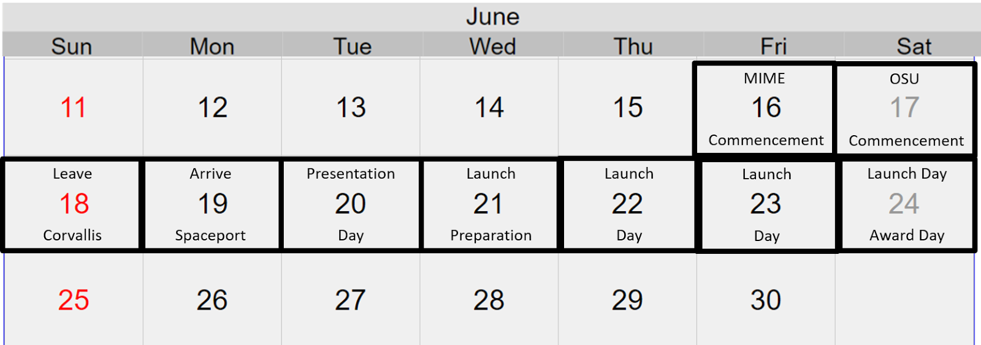
Retrospective of the past 6 weeks
Working with OSU AIAA Chapter Team (High-Altitude Rocketry Team)
Setup Communication Protocol
Revision of Documents
Launch Travel Plans
Issues
Branching
GPS turning on at apogee

Slide 9
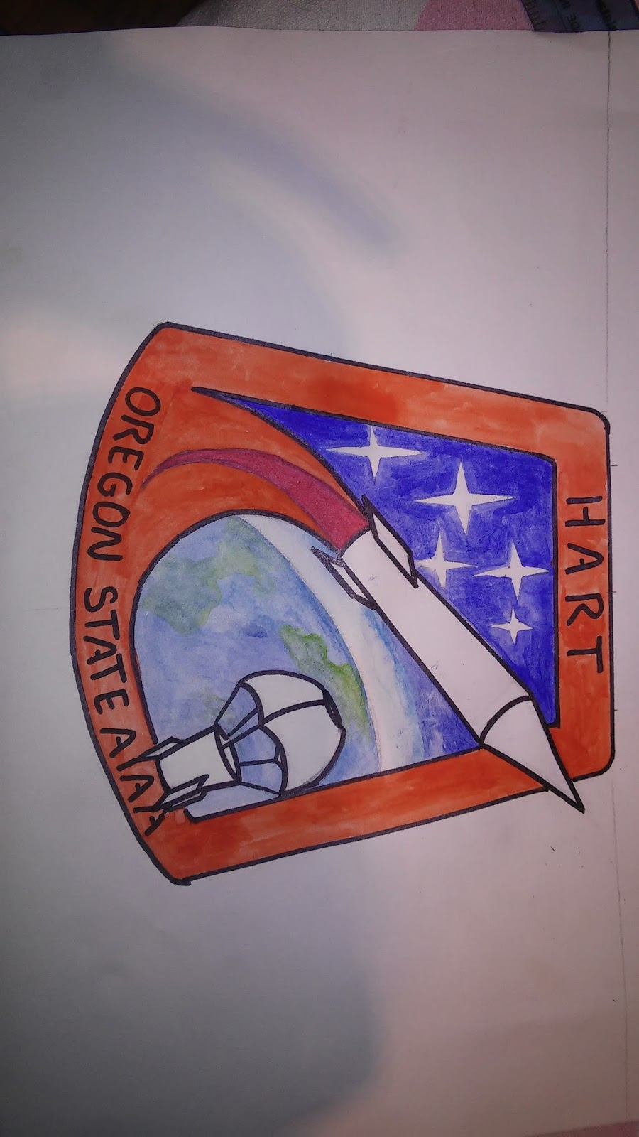
Plans
Create correctly scaled 3D environment
Testing suite
Telemetry Protocol
Avionics Team
Further Revision of Documents
OneNote
Design Document
Get data from launch
Test flight in March

